Slide 1
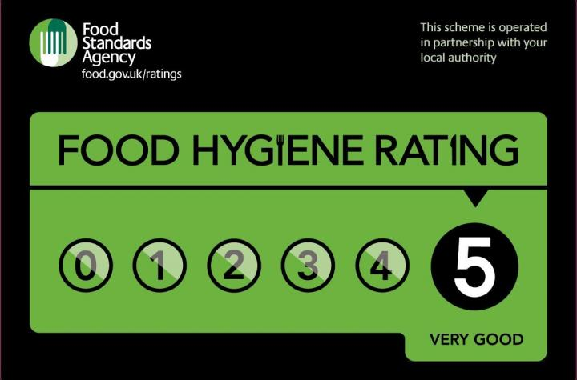


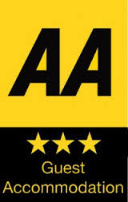

Learning Conversation: Hospitality & Catering
You ask:
There are many different types of rating:
What star rating would a B&B with basic rooms get from the AA?
What does a rating of 5 mean from the food standards agency
Your pupil might say:
If the rooms are basic, it would be a 1 star rating.
It means the hygiene standards are excellent
You might ask them to explain this to extend their answer:
They might have basic rooms, with shared facilities (Bathrooms) Basic breakfast options, tired décor, not the friendliest of staff!
These rating show
  How hygienically the food is handled – how it is prepared, cooked, re-heated, cooled and stored.
  The physical condition of the business –including cleanliness, layout, lighting, ventilation, pest control and other facilities
  How the business manages ways of keeping food safe and documents it

Slide 2

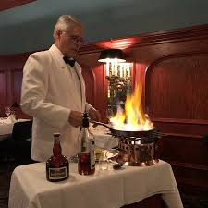
Learning Conversation: Hospitality & Catering
You ask:
Name three types of personal food service?
Outline the main features of Gueridon service
Your pupil might say:
Tray/trolley, home delivery/takeaway, vending machine.
A trained server or chef finishes the cooking at the customer’s table. This is a performance, using specialist equipment, to entertain the customer.
You might want to discuss this question to extend learning:
What are the benefits of a banquet with silver service for a wedding reception?
There are lots of guests to be catered for – this is faster than a buffet and more control of the amount of food each person has.
Menus and a seating plan are chosen beforehand, so waiting staff can identify special dietary needs.
It is an elegant way of serving food which is a luxury and makes the guests feel special and cared for.
Waiting staff collect in dirty plates and cutlery between courses

Slide 3
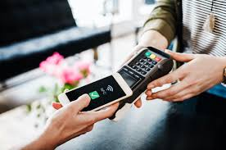
Learning Conversation: Hospitality & Catering
You ask:
How is contactless technology used in the H&C industry?
Explain why some restaurants use cashless payment systems
Your pupil might say:
To pay for rooms or meals, hotel room keycards, contactless check in, QR codes for menus and ordering meals.
They don't need to keep cash onsite, so less risk of theft, it may also reduce insurance premiums. Quicker and more convenient for customers. Cleaner and more hygienic than handling cash which spreads bacteria. Easier to keep accounts as all records are automatically updated. Reduces labour costs and staff errors, counting in cash and cashing up at the end of the day.
To extend learning:
What is an EPOS System?
A machine and software that tracks customer orders and payments.
They are linked to a central computer which records transactions and creates a bill.

Slide 4

Learning Conversation: Hospitality & Catering
You ask:
Why do H&C establishments need to promote their business?
Give 4 examples of how they could use the internet to do this?
Your pupil might say:
To attract new customers
To stand out from their competitors
To build their brand and make them more well known
To increase profit
Increase customer loyalty and inform
Build online presence.
2. Websites, social media, use travel websites to build brand awareness, send marketing emails, advertise on online media (e.g.podcasts) work with influencers
To extend learning:
Explain how businesses increase customer loyalty?
social media
email newsletters
loyalty schemes
Introduce new menus
extended opening hours
themed nights
Special menus

Slide 5
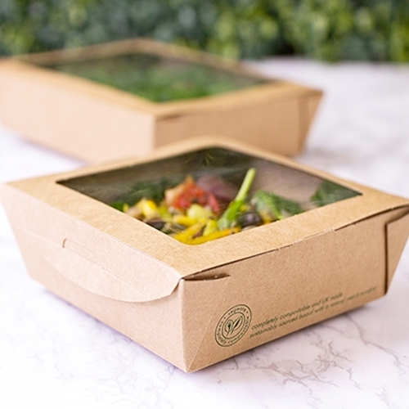
Learning Conversation: Hospitality & Catering
Discuss to extend learning:
You are thinking of opening a takeaway in town what do you need to consider in terms of a) material costs b) Overheads?
Material costs
Ingredients and drinks
Takeaway containers
Napkins & disposable cutlery
Overheads
Rent
Utilities (Gas, electricity, water)
Equipment for cooking and dining
Maintenance of equipment and premises
You ask:
What are overheads?
Your pupil might say:
Regular bills the business must pay to keep the business running. (e.g. rent/ electricity, maintenance costs)

Slide 6

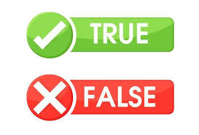
Learning Conversation: Hospitality & Catering
Correction / Extend their thinking…
Seasonal contracts are when someone is employed for a fixed period of time when it is busy e.g Christmas. Zero hours contract is when you have no fixed hours, you can be asked to work at any time – not regular or guaranteed shifts.
That’s not to say people don’t work more if it is very busy!
She may prefer part time, so she can arrange her shifts around her family as she may not have anyone to help with childcare?
Statement:
Seasonal contract and zero hours contracts are the same.
The maximum number of hours a person can work is 48 hours per week
A single mum has been asked to work full time as a commis chef – this is the best option for her and her family.
Answers

Slide 7

Learning Conversation: Hospitality & Catering
You ask:
What does disposable income mean?
You might want to discuss this question to extend learning:
What effect does a strong pound have on the cost of ingredients to UK businesses?
Reduce the cost of ingredients from outside the UK as its cheaper to import things. They can buy more for their money, which could increase profit.
Your pupil might say:
The amount of money a person has after paying for food, bills, taxes and other basic needs. They can spend this money on what they like

Slide 8

Learning Conversation: Hospitality & Catering
You might want to discuss the types of food hazards to extend learning:
Biological – bacteria, viruses, moulds
Chemical – Cleaning chemicals, pesticides on fruit and veg, food additives not used correctly
Physical – Glass, metal, jewellery, false nails, hair, packaging materials
Allergenic – foods that can trigger allergic reactions.
You ask:
What are food hazards?
Your pupil might say:
Substances that can cause harm or illness if eaten.

Slide 9

Learning Conversation: Hospitality & Catering
You ask:
Why is it important for hospitality and catering businesses to follow food safety legislation.
Your pupil might say:
protect customers
obey the law
avoid fines or closure
get a good hygiene rating
protect their reputation
keep staff safe
Extend their thinking:
What is the main Food
Safety Law?
The Food Safety Act 1990
It requires food businesses to ensure:
safe to eat
of the nature, substance and quality expected
labelled and described accurately

Slide 10

Learning Conversation: Hospitality & Catering
You ask:
What is the role of an environmental health officer?
What do they actually do?
Your pupil should say:
An Environmental Health Officer’s role is to protect public health by checking that food businesses are clean, safe, and following the law. They educate businesses, inspect them and take enforcement action when needed.
2. EHO’s:​
Inspect Food Businesses​
Enforce Food Safety Legislation​
Take action if standards are not met​
Investigate complaints and food poisoning outbreaks​
Provide advice and training support

