Slide 1
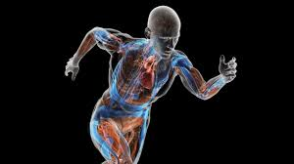



Learning Conversation: GCSE PE
Your pupil might say:
Increase in heart rate.
Increase in muscle temperature.
Increase in stroke volume and cardiac output.
Increase in respiratory rate.
Increase in O2 to muscles
Lactic acid is produced.
You might ask to extend their answer:
Which of these effects is:
  Cardiovascular
  Muscular
  Respiratory
You ask:
What are the short-term effects of exercise on the body?

Slide 2
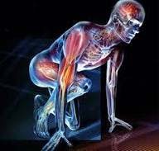
Learning Conversation: GCSE PE
Your pupil might say:
Increased bone density.
Hypertrophy of the heart.
Capillarisation.
Decrease in resting HR.
Increased strength of respiratory muscles.
Increased muscular strength and endurance.
You might ask to help with their answer:
Which of these effects is:
  Cardiovascular
  Muscular
  Respiratory
  Skeletal
You ask:
What are the long-term effects of exercise on the body?

Slide 3
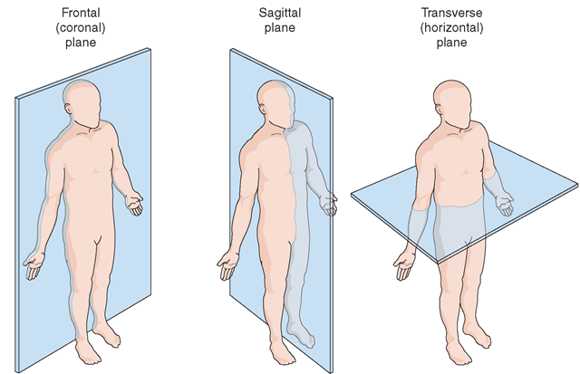
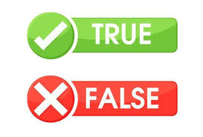
Learning Conversation: GCSE PE
Statement:
Frontal plane divides the body into left and right sides.
An example of a movement happening in the sagittal plane is a tucked somersault.
The longitudinal axis runs from side to side.
An example of a movement around the transverse axis is a forward roll.
Answers:
Correction / Extend their thinking…
Frontal plane divides the body into front and back.
Flexion and extension happen in the Sagittal plane.
The longitudinal axis runs from top to bottom – it's the LONG one!
This axis runs from side to side like a table football player!

Slide 4
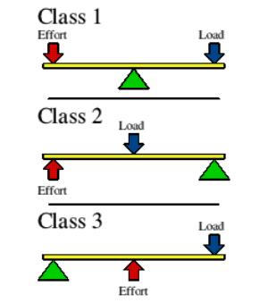
Learning Conversation: GCSE PE
Your pupil might say:
1 2 3
F L E
This shows the middle component of each lever. The other two components go either side.
You might ask to help with their answer:
What are the examples for each type of lever in the body?
Which muscle provides the effort for each?
You ask:
What is the best way to remember the order of the three classes of lever in the body?

Slide 5

Learning Conversation: GCSE PE
Statement:
The Standing broad jump is a method for measuring muscular endurance.
The acronym for remembering the principles of training is SPOR.
Continuous training is a method of training used to improve Cardiovascular Fitness.
There are 4 components of a warm-up.
Answers:
Correction / Extend their thinking…
This test measures Power. Muscular endurance is measured using the press up test.
This stands for Specificity, Progression, Overload and Reversibility
Another method is Fartlek training.
There are 5! Pulse raiser, mobility, stretch, dynamic movements, skill rehearsal.

Slide 6
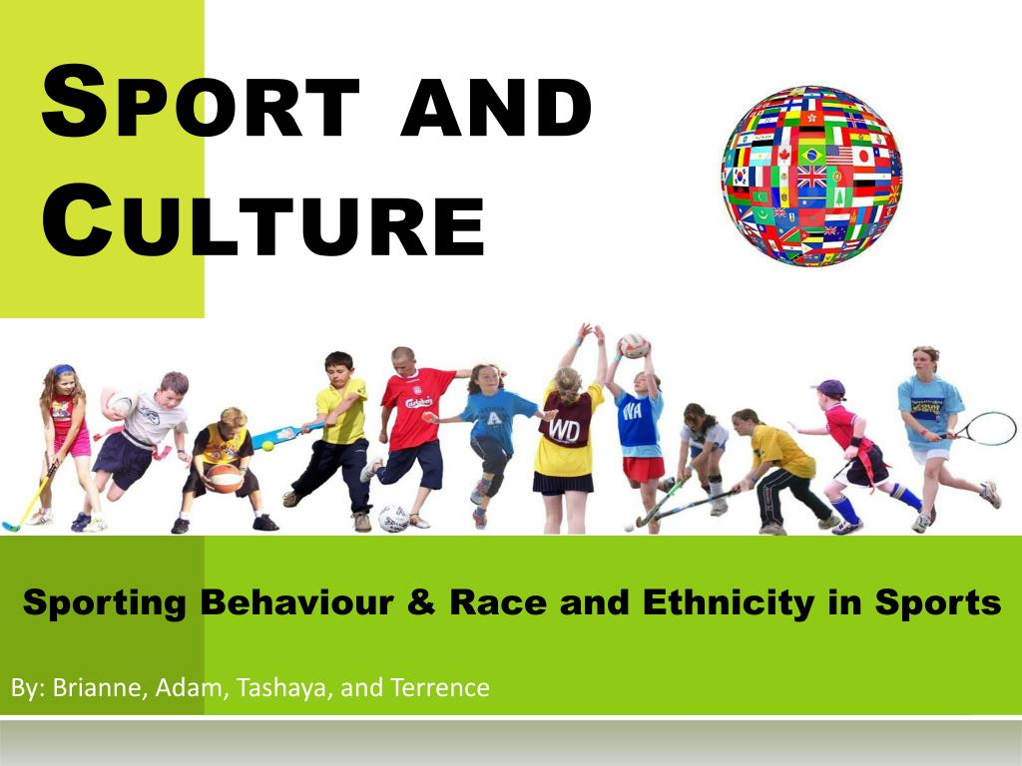
Learning Conversation: GCSE PE
Statement:
People with a disability access as much sport as those without a disability.
Older people take part in less sport/physical activity than younger people.
Children have the highest participation rates in sport and physical activity.
Women do more physical activity than men.
Answers:
Correction / Extend their thinking/Reasons for …
People with a disability have restricted access and a lack of specialist equipment/facilities.
Older people may lack confidence and have lower fitness levels.
Children do more physical activity in school. Adults have less free time.
There is more opportunity, funding and media attention for perceived male sports although recent female sporting successes is helping to change this.

Slide 7
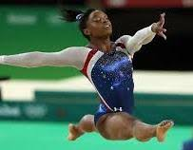
Learning Conversation: GCSE PE
You ask:
What are the 5 characteristics of Skilful movement?
Your pupil should say:
Remember PFACE!!
Pre-determined
Fluent
Aesthetic
Co-ordinated
Efficient

Slide 8
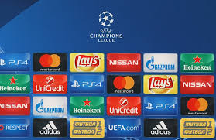
Learning Conversation: GCSE PE
Your pupil might say:
It shows the relationship between SPONSORSHIP, SPORT and the MEDIA.
EG: Premier league football is a commercial success which attracts media attention and further sponsorship.
Extend their thinking:
What is the difference between SPONSORSHIP and COMMERCIALISATION?
Sponsorship – The funding of individuals/teams to make a profit.
Commercialisation - The process of running sport as a business to make profit.
You ask:
What does the Golden Triangle show?
Give an example that shows this relationship.

Slide 9
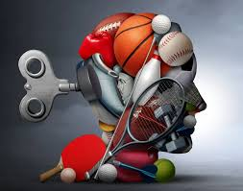
Learning Conversation: GCSE PE
You ask:
What are the 4 types of GUIDANCE?
What are the 6 types of feedback?
What does SMART stand for?
Give 3 methods an athlete may use to mentally prepare for an important match?
Your pupil should say:
Visual, Verbal, Manual, Mechanical.
Intrinsic + Extrinsic, Positive + Negative, Knowledge of Results + Knowledge of Performance.
Used to set goals: SPECIFIC, MEASURABLE, ACHIEVABLE, RECORDED, TIMED.
Positive thinking, Selective attention, Mental rehearsal, Imagery.

Slide 10


Learning Conversation: GCSE PE
Consequences of a sedentary lifestyle:
Increased risk of CHD.
Lack of self-esteem.
Lack of belonging to a group.
Loneliness.
Poor self-image.
Poor fitness.
Increased risk of obesity.
Risk of higher blood pressure.
You ask:
Categorise the consequences of a sedentary lifestyle shown into PHYSICAL, EMOTIONAL or SOCIAL?
PHYSICAL
EMOTIONAL
SOCIAL
SOCIAL
EMOTIONAL
PHYSICAL
PHYSICAL
PHYSICAL

