Slide 1



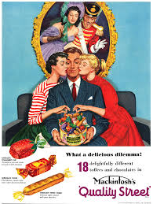
Learning Conversation: Media Studies - Advertising
You ask:
How does the Quality Street advertisement represent gender?
Your pupil might say:
The advert’ suggests a male-dominated (patriarchal) society in terms of ‘choice’.
The dress code reflects the modern working businessman, who may be perceived as the ‘provider’ of the brand.
This links to Mulvey’s male gaze theory (a feminist theoretical perspective) in relation to the framing. The male character directs the audience’s eyes to the product, which carries significant phallic symbolism.
You might ask to help with their answer:
What is a patriarchal society and how does this advert’ reflect this idea?
How are the women dressed and positioned (think about the colours of the sweets) and what might this suggest?
How is the man dressed and positioned? What might this suggest?

Slide 2

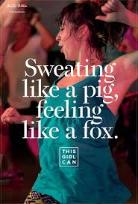
Learning Conversation: Media Studies - Advertising
Statement:
This Girl Can is a national campaign developed by Sport England.
2. As a result of the campaign, 1.6m women started exercising.
Sweating Like a pig and feeling like a fox is a metaphor.
Answers:
Correction / Extend their thinking…
The purpose of the campaign is to break down the primary barrier holding women back from participating in sport – the fear of judgement.
2. The number of women playing sport and being active is increasing faster than the number of men.
3. No – it is a simile because it makes a comparison using the word ‘like’. A metaphor compares two things saying that one IS the other.

Slide 3
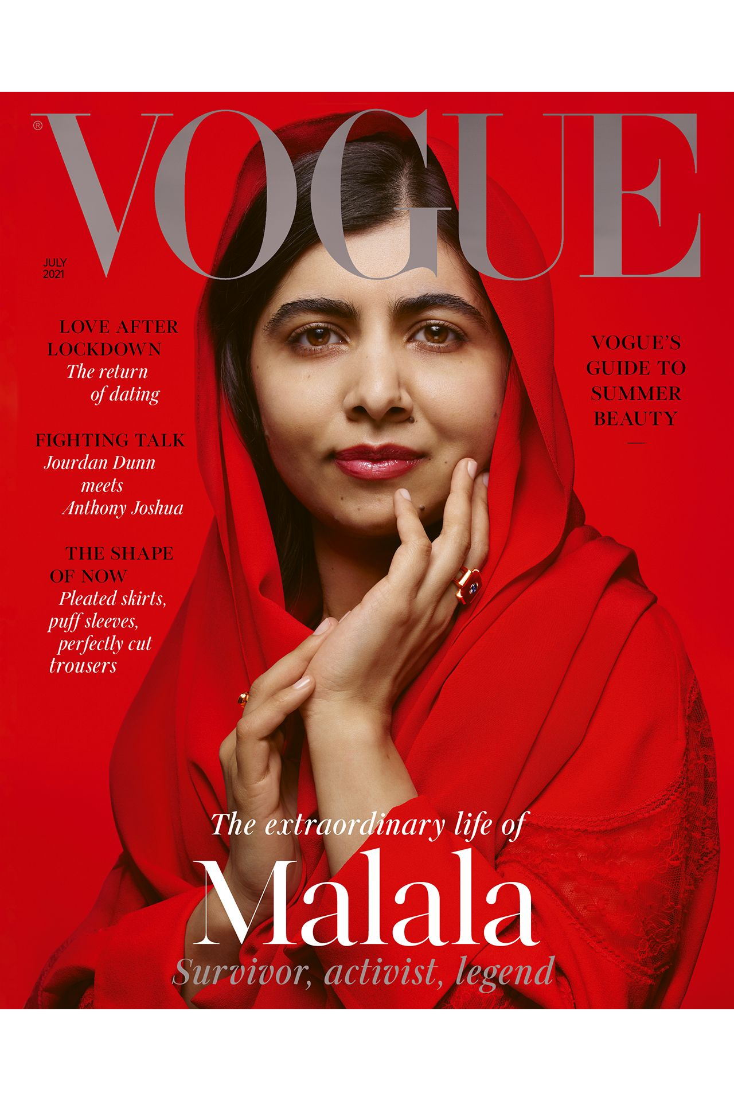
Learning Conversation: Media Studies - Magazines
You ask:
What are the connotations of the colour red on the Vogue magazine cover?
Your pupil might say:
Red suggests love and passion (?)
Red connotes romance and danger (?)
The connotations of red mean that Malala was injured by the Taliban. (?)
The dominance of red in the colour palette connotes that Malala is a strong and powerful survivor.
You might ask to help with their answer:
The use of the dominant colour red in this context suggests celebration, joy, luxury, power and strength, a call to action to identify with Malala, the survivor/activist/legend.

Slide 4
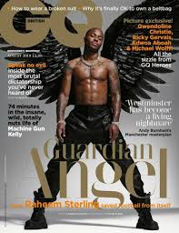
Learning Conversation: Media Studies - Magazines
You ask:
How is Raheem Stirling represented on the front page of GQ magazine?
Your pupil might say:
Raheem Sterling is represented (powerfully/effectively/successfully) on the front of GQ magazine.
The long, low angle shot of his body language and stance connote/suggest confidence.
The anchorage text (Guardian Angel) links to Raheem being a respected role model for people facing racism within the football industry.
You might ask to help with their answer:
Is religious iconography used to suggest/connote that he is a good person? How?
Does this image subvert Alvardo's theory of racial stereotypes? (exotic
funny/pitied/dangerous)

Slide 5
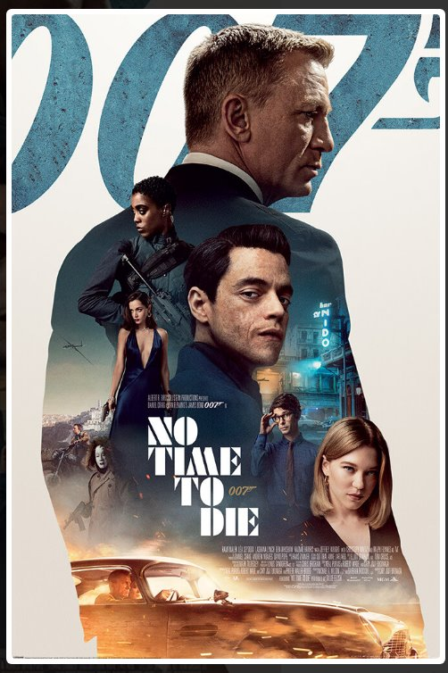
Learning Conversation: Media Studies – Film Posters
You ask:
What type of shot is the dominant image in the film poster?
Who is the protagonist?
Who would the characters on the posters be if we consider Propp's theory of Character Archetypes?
Your pupil might say:
The dominant image is a mid-shot of James Bond, smartly dressed.
This suggests that he is the film’s protagonist.
According to Propp’s theory, he would be considered the ‘hero’.
You might ask to help with their answer:
Dominant means – the main image.
A Protagonist is the hero – an antagonist is the villain.
Propp's idea is that all stories contain similar character types: The Hero/The princess/the villain/the helper etc.

Slide 6
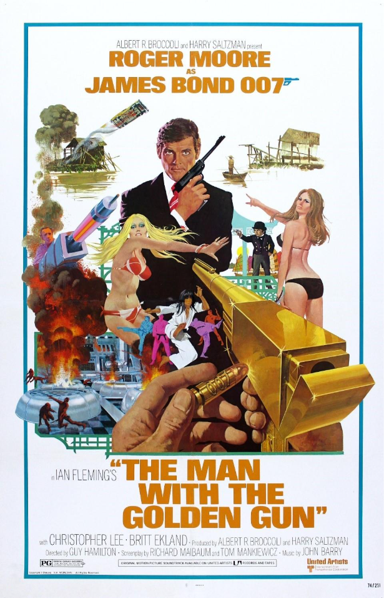
Learning Conversation: Media Studies – Film Posters
Your pupil should say:
One of the main themes in this Bond film was an actual world event – the 1937 global energy crisis. With the embargo on oil, countries were considering alternative power sources. This is portrayed through the iconography of the power plant and the related explosions.
The film is set in the middle of the 1973 energy crisis, when the oil producing Arab nations proclaimed an oil embargo causing an oil crisis. This is hinted at through the poster’s iconography of the power plant in the lower left corner and the energy beam directed at Bond.
You ask:
What was the energy crisis at this time – how might this have influenced the poster / film?

Slide 7
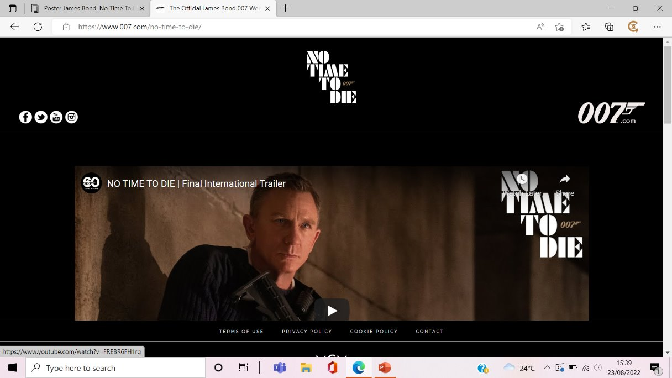
Learning Conversation: Media Studies – Film Posters + Websites
You ask:
Why is the 007 website important for film releases?
Conversation Prompts:
1. How does the 007website allow producers to reach audiences?
2. How does the 007 website reinforce the Bond brand?
Your pupil might say:
The 007 website allows the producers to reach the audience on a single platform.
2. The website reinforces the Bond brand through digital convergence + synergy to reach global audiences.

Slide 8
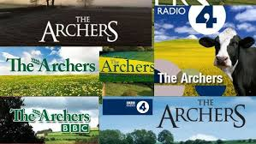
Learning Conversation: Media Studies - Radio
You ask:
List at three ways The Archers uses digital convergence to reach its audience
Describe some of the issues that are contained in the storylines and explain how audiences might relate to them.
Your pupil should say:
- website, Facebook, Instagram
- agricultural issues within the farming community, family relationships, domestic abuse, alcohol addiction and more.
Audiences might recognise and relate to these issues in their own lives and be educated about how to resolve them.

Slide 9
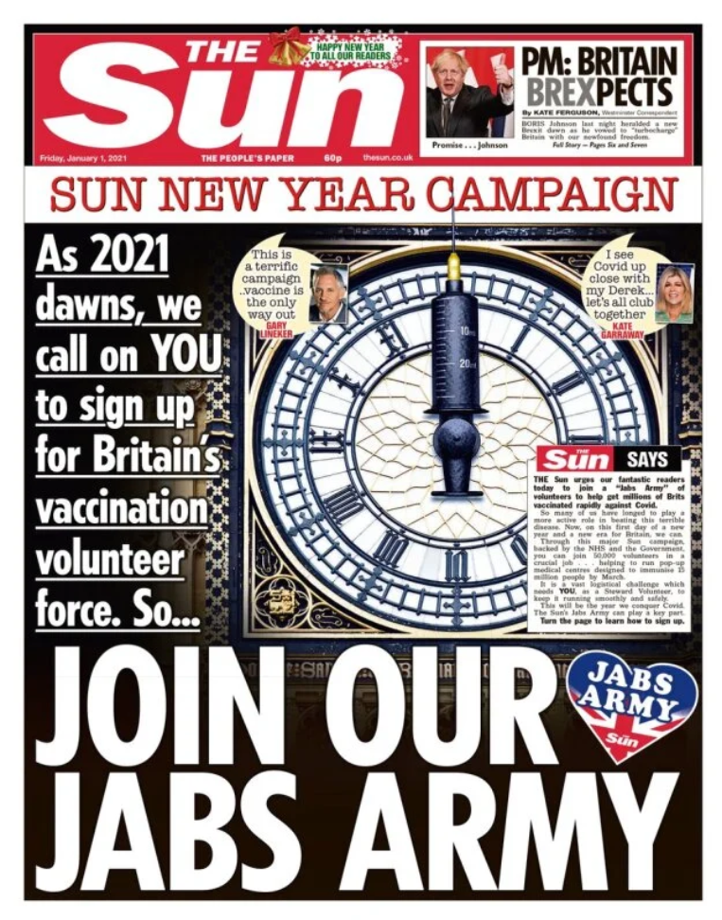
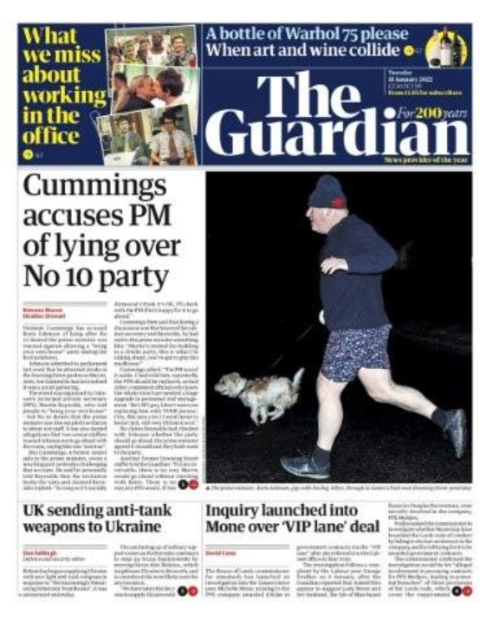
Learning Conversation: Media Studies - Newspapers
You might suggest to help with their answer:
Powerful or emotional words make readers feel a certain way.
Example: “disaster,” “shock,” “hero.”
Photos can make a story seem more serious, sad, exciting, or important.
Example: A big picture of a fire makes the event look dramatic. Big headlines and bold fonts show what is most important.
Front‑page placement makes a story seem more important.
Red = urgent or dangerous. Blue = calm or trustworthy.
Short, dramatic headlines grab attention and set the tone.
Example the verb 'chaos', written in capitals “CHAOS AT AIRPORT!” sounds urgent.
You ask:
How do newspapers use media language to create meaning?
Your pupil might say:
1.Things like photos, colours and images are used to make the read think a certain way.
2. Tabloid like The Sun use more images than Broadsheets like The Guardian
3. Layout – Masthead, columns etc.
4. Colours are used to suggest/connote certain things.
5. Headlines grab the readers' attention.

Slide 10
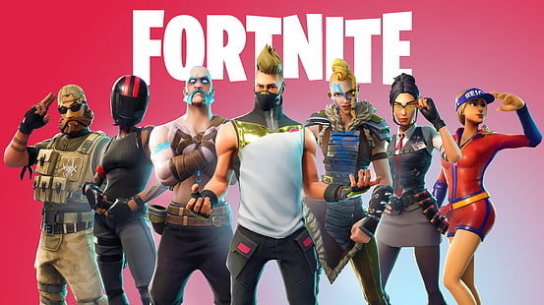

Learning Conversation: Media Studies – Video Games
Statement:
Fortnite’s audience is 78% male
2. Computer games are regulated by PEGI (Pan European Game Information)in the UK?
3. The word 'regulation' means that all computer games have to be at least a 15 certificate.
Answers:
Correction / Extend their thinking…
True!
2. In the UK, video games must show an age rating (like 7, 12, 16, 18). These ratings are given by PEGI, and the system is enforced in UK law.
3. The word 'Regulation' means Age Ratings: Systems like ESRB (North America) and PEGI (Europe) classify games based on content like violence or language to help parents make informed choices.

