Slide 1
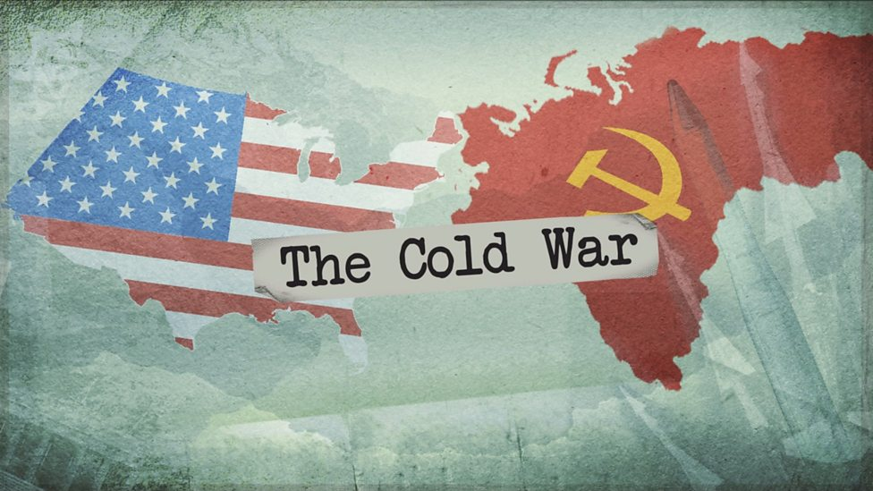



Learning Conversation: History
Your pupil might say:
The Potsdam Conference and the atomic bomb caused tension and the arms race.
There was competition over control in Europe with the satellite states and Iron Curtain.
The division of Berlin and Germany became the worst crisis with the 1948 Blockade.
You might ask to help with their answer:
Why did the Grand Alliance fail at the end of WW2?
What happened to eastern Europe after WW2?
Which country in Europe was the most divided and therefore the biggest problem?
You ask:
How did relations between the USA and the USSR worsen in the 1940s?

Slide 2
Learning Conversation: History
Your pupil might say:
The Berlin Crisis – Berlin Wall being created in 1961.
The Cuban Missile Crisis in 1962.
The Prague Spring in 1968.
You might ask to help with their answer:
Which city was divided during the Cold War?
Which Caribbean island was involved in the worst crisis of the Cold War?
Which country in Europe tried to break away from the Warsaw Pact?
You ask:
Which key events increased tension during the 1960s?

Slide 3
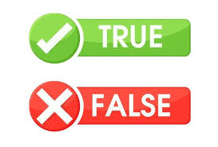
Learning Conversation: History
Statement:
The president who started the Second Cold War was Kennedy.
The thawing of the Cold War in the 1970s is called Détente.
Gorbachev introduced reforms to the USSR like Glasnost and Cominform.
President Reagan scared the USSR by announcing the development of SDI (Star Wars).
Answers:
Correction / Extend their thinking…
Reagan was the president in the 1980s who increased tensions. Why did he do this?
Can they name an example of Détente in the 1970s?
Glasnost and Perestroika – why did Gorbachev do this?
What did SDI force the USSR to do?

Slide 4
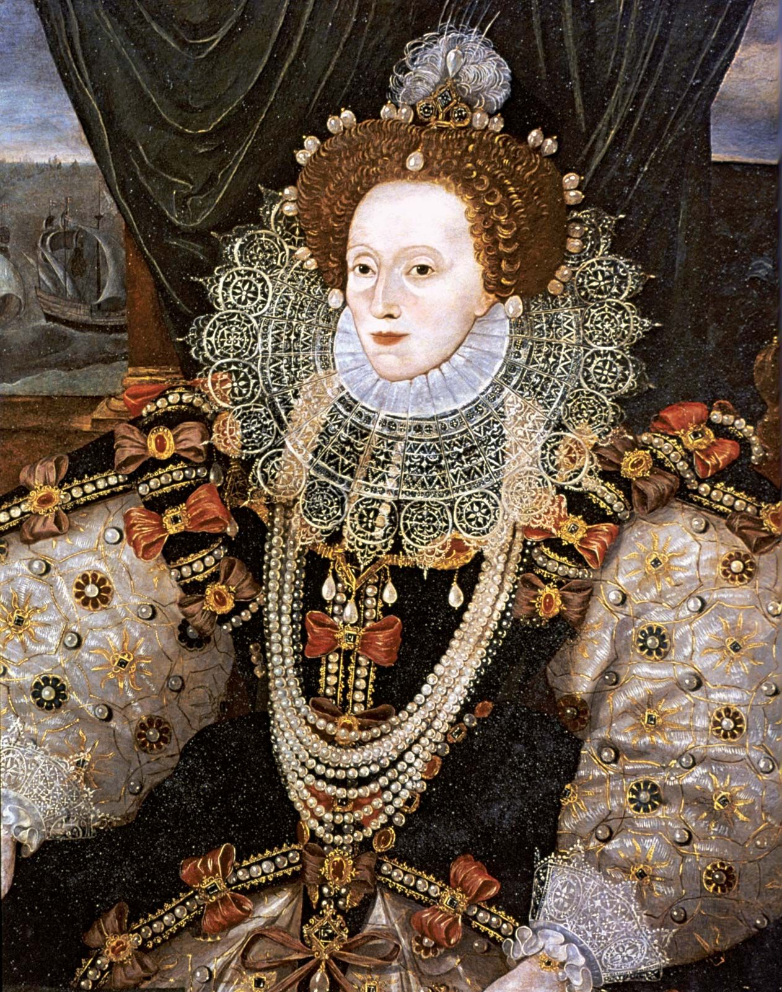
Learning Conversation: History
Your pupil might say:
Religious problems due to the Reformation – she was a Protestant, and most English people were Catholics.
The economy was in massive debt (£300,000) and people were suffering.
As a female monarch, Elizabeth was not respected by the men in her government or by foreign nations like Spain and France.
Many people believed Elizabeth was not legitimate due to her parents’ marriage so wanted Mary, Queen of Scots to be queen.
You might ask to help with their answer:
What were the problems over religion?
Why might Elizabeth face a lack of respect as Queen?
Who ruled England before Elizabeth? What problems did they leave behind?
You ask:
What problems did Elizabeth face when she took the throne?

Slide 5
Learning Conversation: History
Your pupil might say:
Religion – threats to her Church from Catholic rebellions and Puritan challenges.
Spain – supported rebellions, sent the Armada, conflict in the Americas and the Netherlands.
Poverty – many English people lived below the poverty line and needed support.
Mary, Queen of Scots – numerous rebellions after Mary arrived in 1568 until her execution in 1587.
You might ask to help with their answer:
Which country was Elizabeth constantly challenged by?
Who was Elizabeth’s cousin who was heir to the throne?
How was her Church challenged?
You ask:
What were the main problems that Elizabeth faced between 1558 and 1588?

Slide 6
Learning Conversation: History
You ask:
What was the new type of entertainment in the Elizabethan period?
Which religion was Elizabeth’s Church mainly based on?
Who was the king of Spain?
Who was Elizabeth’s heir?
Which European country did Elizabeth support against Spanish control?
Your pupil should say:
Theatre
Protestant
Philip II
Mary, Queen of Scots
The Netherlands

Slide 7
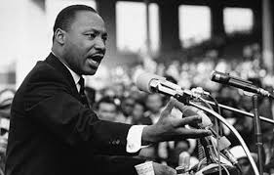
Learning Conversation: History
Your pupil might say:
US tactics – failed to defeat the Viet Cong and wasted billions of dollars.
Viet Cong tactics – clever and had a huge psychological impact for little cost, like booby traps and tunnels.
The media – portrayed the war as a loss on new technology like colour TVs and covered key events like My Lai.
Protests – put pressure on the presidents to withdraw from the war and led to events like Kent State.
You might ask to help with their answer:
What were the main methods of fighting for the USA and the Viet Cong in the war?
What did many Americans think about the war?
How did Americans learn about the reality of the war in Vietnam?
You ask:
Why did the USA lose in the Vietnam War?

Slide 8
Learning Conversation: History
Statement:
The Montgomery Bus Boycott was the first civil rights protest.
The Black Power Salute was used at the Mexico Olympics.
The Selma March led to the Voting Rights Act.
Martin Luther King’s campaign against poverty in northern cities like Chicago was a success.
Answers:
Correction / Extend their thinking…
The Brown v. Topeka Supreme Court ruling was the first in 1954. Why was education the first target of the civil rights movement?
Can they name the athletes who took part?
Can they name two other civil rights marches?
The campaign failed to improve living conditions. Why did it fail?

Slide 9
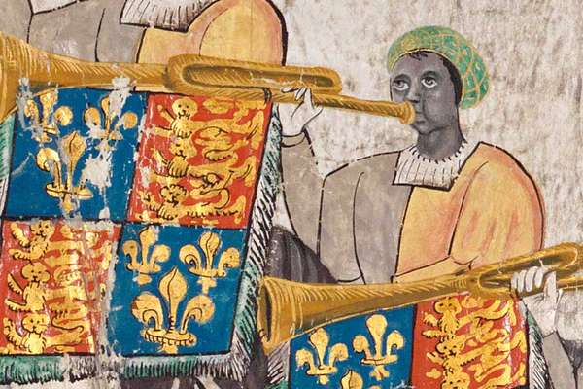
Learning Conversation: History
Your pupil might say:
Fleeing persecution or war – like the Huguenots, Palatines, Flemish weavers, Jewish migrants and WW1 and WW2 migrants.
To contribute to the economy - Dutch engineers, Lombard bankers, Irish and Italian navvies, Caribbean workers after WW2.
Invited by those in power – Jewish migrants, Flemish weavers, Huguenots, Caribbean migrants.
Connections with empire – Indian and African migrants, Caribbean migrants, Irish migrants.
Conquest – Vikings and Normans.
You might ask to help with their answer:
What are the main factors which push people to migrate?
What are the main factors which pull people to migrate to a certain country?
How have events like the Reformation, the Industrial Revolution, the growth of the British Empire and WW1 and WW2 affected migration?
You ask:
What have been the main reasons for migration to Britain through time?

Slide 10
Learning Conversation: History
You ask:
Which group of migrants arrived in Notting Hill.
Name a migrant group who has had a mainly positive experience in Britain.
Name a migrant group who has had a mainly negative experience in Britain.
Name a migrant group who has had a large cultural impact on Britain.
Which period of time do each of these migrants arrive in:
  Dutch
  Caribbean
  Viking
  Irish
  Jewish migrants.
Your pupil should say:
Caribbean.
Normans, Huguenots, Flemish weavers, Dutch, Germans.
Jewish migrants, Roman and Sinti migrants, Palatines, Irish migrants, African and Indian migrants.
Vikings, Normans, German, Dutch, Irish, Caribbean, Indian migrants.
They are:
  Early modern
  Modern
  Medieval
  Industrial
  All four time periods: Medieval, Early modern, Industrial, modern.

